Slide 1
飲 食 與 健 康
Diet and health issues

Slide 2
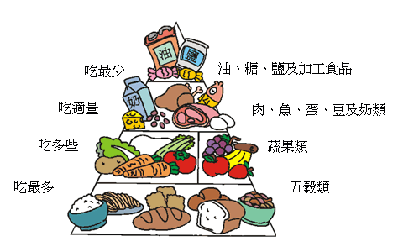
健康飲食金字塔

Slide 3
GCE Speaking Exam
Allocated task stimulus sheet
15 minutes preparation time
Make notes on a A4 size paper
- Summary of the passage
- Response to the bullet points
5-6 minutes presentation (monologue)
30% of AS award

Slide 4
GCE Speaking Exam
Common Topic areas
Food, diet and health
Transport, travel and tourism
Education and employment
Leisure, youth interests and Chinese festivals*
* New year, mid-autumn festival,
dragon boat festival,
Ching Ming (Qing Ming)

Slide 5
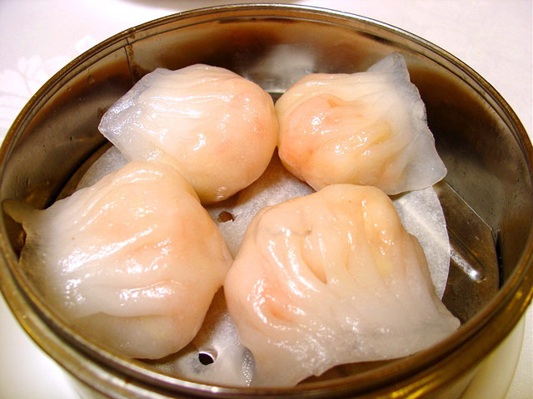
1
蝦餃

Slide 6
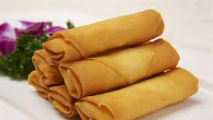
2
春卷

Slide 7
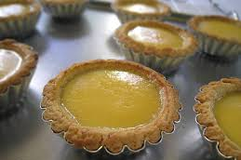
3
蛋撻

Slide 8
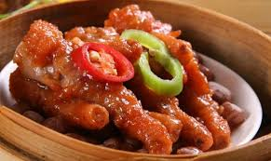
4
鳳爪

Slide 9
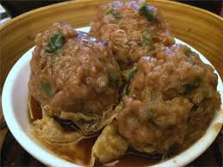
5
山竹牛肉

Slide 10
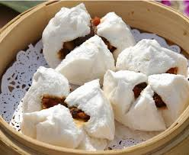
6
叉燒包

Slide 11
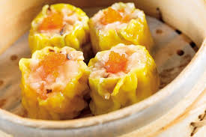
7
燒賣

Slide 12
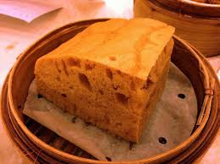
8
馬拉糕

Slide 13
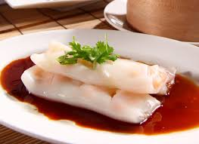
9
腸粉

Slide 14
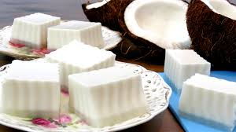
10
椰汁糕

Slide 15
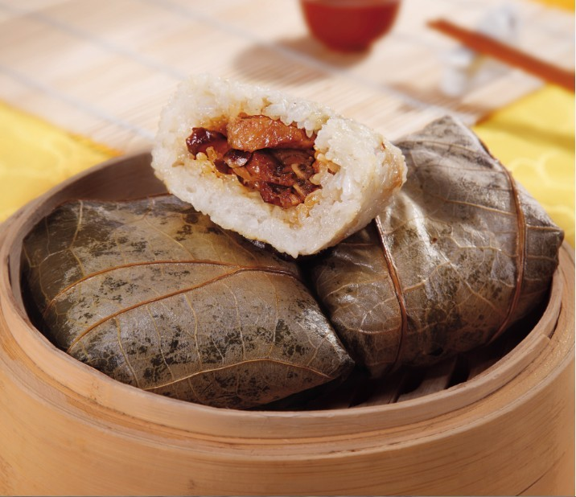
11
糯米雞

Slide 16
食物的味道
酸酸辣辣：sour and spicy
香脆：crunchy
新鮮：fresh
香濃：rich in flavour
香滑：fragrant and smooth
鮮嫩多汁：tender and juicy
香噴噴：sweet-smelling
油膩：greasy

Slide 17
概括形容味道
美味：tasty
色香味俱全：perfect in colour,
aroma and taste
3.味濃：strong taste
4.垂涎三尺：make one’s mouth water
5.胃口大開：appetising

Slide 18

for good quality performances in GCE Oral Examination
A. Content and Understanding
1. Gave developed and detailed answers.
2. Demonstrating thorough consideration on the issues
relating to the stimulus.
3. Start with a full or partial translation of English stimulus.
4. Use the English stimulus thoroughly and properly.
5. Cover all the bullet points well.
6. Enrich the speech by providing fully developed ideas.
7. Speak logically and accurately at native or near native
standard.

Slide 19
Candidates who were unable to achieve in the upper mark
bands as they:
* struggled to speak for the full time allocation (i.e. 5 to 6 minutes)
*spoke over 6 minutes (the remainder of the presentation was not
marked)
*gave limited or no response to the stimulus (i.e. bullet point 1)
*became repetitive
*talked freely without responding to all five bullet points
*gave a lot of irrelevant responses
*fail to extend the responses to the full range of all bullet points
*gave an unbalanced presentation (e.g. spent too much time on
the first three bullet points and rushed through the last two
bullet points)

Slide 20
B. Quality of language
1. Clear pronunciation and good control of complex language
structure.
2. The weaker candidates with the following problems:
*spoke with tones which sometimes caused misunderstanding
*spoke with hesitation which stemmed from uncertainty
*spoke with simplicity of language expressions or structures or limited vocabulary

Slide 22
2015 GCE
Stimulus 7 : Eating dim sum
Bullet point 1
State what the above article is referring to ( a full summary is not required).
Time allocation : 1 minute

Slide 23
Bullet point 2
Why do people like to eat dim sum ? Give details.
Bullet point 3
What do you like to eat and drink when you are with friends ?
***Bullet point 4
What are your opinions of Chinese food ? Why ?
***Bullet point 5
How do you maintain a healthy lifestyle? Give details.
Time allocation : 4 minutes

